Slide 1



K.S. School of Engineering and Management
Department of Electronics and Communication Engineering
INTERNSHIP PRESPENTATION
on
“SMART GEYSER”
Internship carried out at
Under guidance of
SHANTHALA G.M
Associate Professor Dept. of ECE
NAME:SUSHMA.S
USN:1KG16EC103

Slide 2
CONTENTS
About company
Introduction to smart geyser
Work assigned
Work completed
Execution
Multisim software
Multisim toolbar
Conclusion

Slide 3
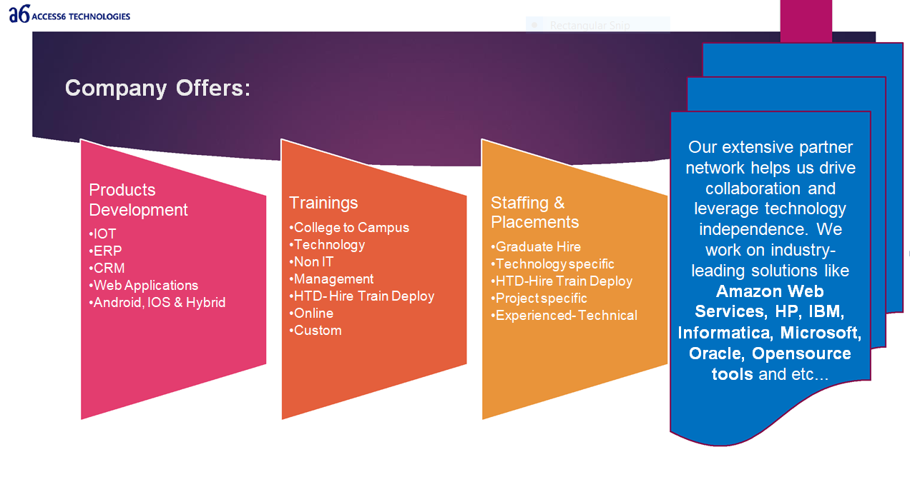
COMPANY PROFILE
Access6 is a Global Information and Technology Company. We have clear philosophy of “Connecting Dots…” which aims to do business and provide complete satisfaction to customers by practicing best practices by understanding the business needs and providing subsequent solution to the Clients, we aim to evolve as a complete and ‘One Stop Information and Technology Company’. Access6 is a Global Information and Technology Company’.

Slide 4
INTRODUCTION TO SMART GEYSER
Water is an integral part of our lives. Aside from being a bare necessity for survival, it is perhaps the single most important part of our daily living.
Over time, people have discovered that hot water is more useful compared to lukewarm water, and with that, technology has offered us many options to obtain hot water.
Water heaters utilize an energy source to be able to heat water until it reaches the programmed temperature level. And it consumes more time to reach that level.
Here is the latest addition to the many types of water heaters which is the Smart Water Heater.
Department of Electronics and Communication Engineering, KSSEM

Slide 5
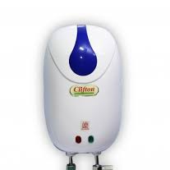
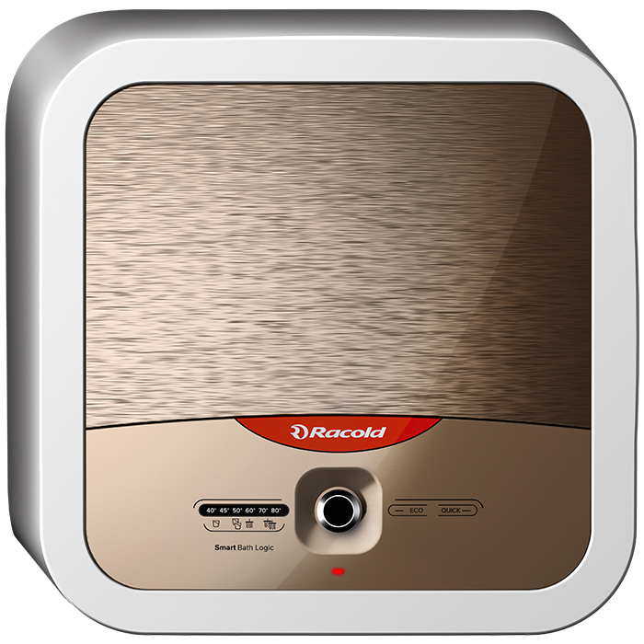
Geyser consumes large amount time to transfer the heat, to reduce the time consumption we have come across a Smart Geyser which consumes very less amount of time to transfer the heat to required temperature by using the components listed below.
Where these geyser consumes less amount of time to heat water for required temperature.

Slide 6
WORK ASSIGNED
Smart Technology which Brings Safety
Saves Energy
User Friendly

Slide 7
WORK COMPLETED
METHODOLOGY
To achieve the above objectives we make use of different sensors so that it can sense and alert the user.
To save energy we make use of arduino uno, which sense the required temperature and gives out hot water without over heating.
To make it user friendly , we can operate geyser in tip of our fingers instead of manual operation.

Slide 8
EXECUTION
HARDWARE COMPONENTS
ARDUINO UNO
PIR SENSOR
VOICE RECOGNITION MODULE
WIFI MODULE
THERMOSTATS
BUZZER
PIR SENSOR
FINGERPRINT SENSOR

Slide 9
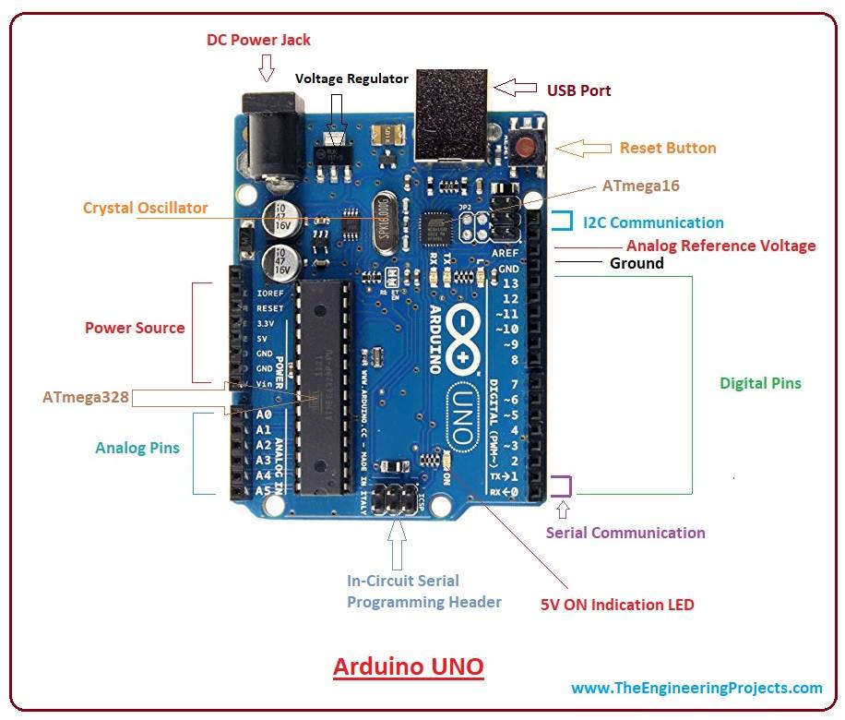
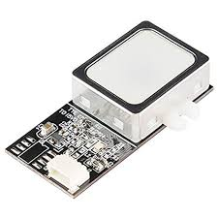
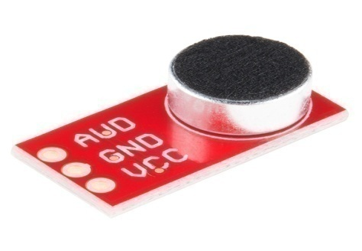
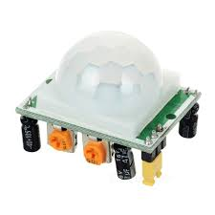
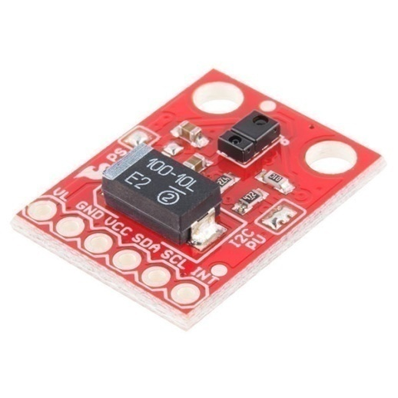
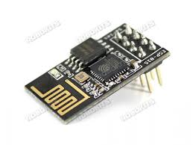
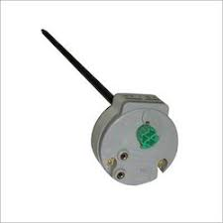

Slide 10
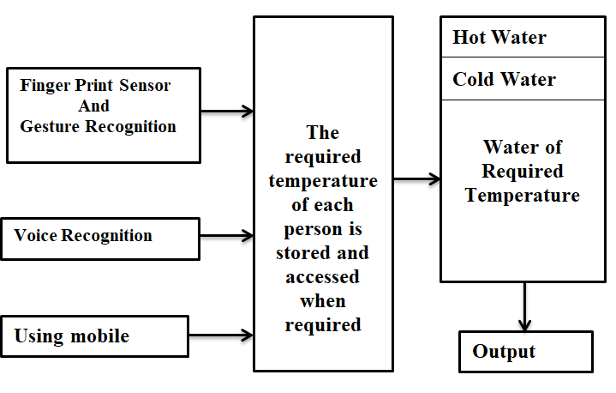
ARCHITECTURE

Slide 11
WORKING PRINCIPLE
The architecture tells us about the basic working procedure of the smart geyser,
Firstly giving input through either figure print or gesture recognition sensor .
System senses the gesture done by user.
Sets the temperature according to user needs.
Changing the temperature if required, through voice recognition sensor .
Information is stored in memory once it sense the data.
Through the help of thermostat water temperature is set according to user information.

Slide 12
FLOW CHART
START
PIR SENSOR
SENSE MOTION
LIGHTS OFF
SWITCH ON LIGHTS
USING VOICE AUTOMATION, TELL THE USER THE DEFAULT TEMPERATURE
CHANGE THE TEMPERATURE TO REQUIRED VALUE
OK?
Tap
STOP

Slide 13
TECHNICAL OUTCOME
This project gives us an over view of smart geyser with latest technologies incorporated within.
Where it is capable of reading the temperature from its database just by taking the input as gesture and finger print.
It gives out hot water without wasting much amount of time and energy.

Slide 14
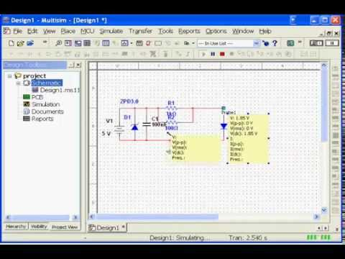
MULTISIM SOFTWARE
Multisim software integrates industry-standard SPICE simulation with an interactive schematic environment to instantly visualize and analyze electronic circuit behavior.

Slide 15
MULTISIM TOOLBARS
The toolbars listed below are available in Multisim:
Standard Toolbar
Main Toolbar
Simulation Toolbar
View Toolbar
Components Toolbar
Virtual Toolbar
Graphic Annotation Toolbar
Instruments Toolbar

Slide 16
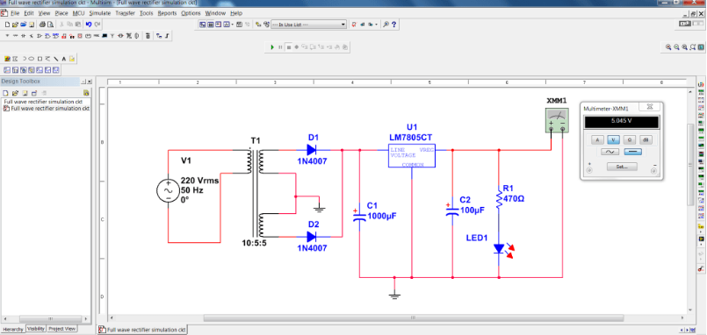
Designing of PCB Layout for Full wave rectifier circuit
Simulation result

Slide 17
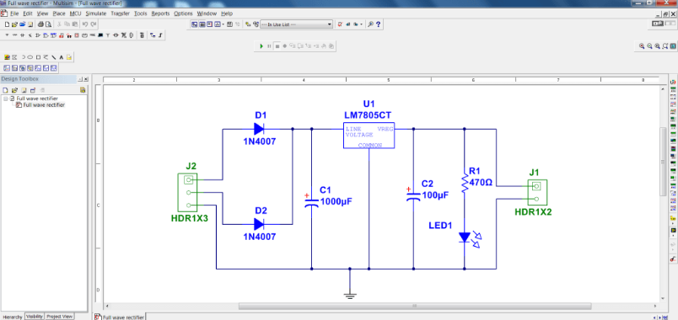
PCB layout design

Slide 18
CONCLUSION
To implement a new real time project called ‘smart geyser’, we have designed a flow chart and architecture of a system.
which tells us about working and overall outcome.
This incorporates different types of sensors, and wireless technologies like Wi-Fi, Bluetooth network with custom application software, fixtures and enclosures to construct the complete test system.
Multisim helps us easily visualize and understand the behavior of electronics with 30+ intuitive simulated instruments.

Slide 19
Thank you

Slide 20
Any questions????

